Slide 1
MECHANICAL CHARACTERIZATIONS OF Ti6Al4V MANUFACTURED BY LASER METAL DEPOSITION PROCESS (LMD)
BATCH 30
Project Members
N.F. SAJITH 211419114251
A. SAKTHIVEL 211419114252
D. SAMUEL JAIKUMAR 211419114253
V. SANJAY 211419114257
Batch No: 03
Under the Supervision
Of
Mr. I. JOHN SOLOMON, M.E.,
Assistant Professor ,
Department of Mechanical Engineering,
Panimalar Engineering College.

Slide 2
ABSTRACT:
This project reviews the state-of-the-art of an important , rapidly emerging, manufacturing technology that is Metal Additive Manufacturing or 3d Printing
AM has the potential to revolutionize the global parts manufacturing and logistics landscape
Some characteristics of this manufacturing technique is the prime focus of this paper

Slide 3
INTRODUCTION:
Metal Additive Manufacturing is a type of additive manufacturing that uses a heat source – such as a laser or electron beam – to heat metal in powder or wire form so that it consolidates to form an object
Metal Additive Manufacturing is considered to be one of the disruptive technologies, as it revolutionizes how we approach design and manufacturing

Slide 4
METAL AM APPLICATIONS:
Aerospace industry – Fuel Nozzles
Automotive industry – Cylinder heads, Crankshafts, etc. (prototypes)
General Engineering – Manifolds, Turbine blades, Complex Oil Channels, Valves, Waveguides, etc.
Dies and Moulds

Slide 5
OBJECTIVE:
To test various mechanical properties of additively manufactured metal parts
To compare the same part with that of conventionally manufactured part
Analyze and interpret the result

Slide 6
TESTS TO BE DONE:
Tensile test
Hardness test
SEM analysis

Slide 7
MATERIAL USED:
Grade 5 Titanium alloy is the most widely used of all the titanium grades. Titanium alloys are known to be light weight alloys with excellent corrosion resistance, very high tensile strength and toughness. It can be heated up to 400°C (750°F), and has good tensile properties at room temperature, creep resistance up to 325°C and very good fatigue strength.

Slide 8
LASER METAL DEPOSITION PROCESS (LMD)
Laser Metal Deposition (LMD), also known as Directed Energy Deposition (DED), is a modern additive manufacturing process that utilizes a high-powered laser beam to melt and fuse metallic powders or wires onto a substrate to build complex 3D structures. This process offers unique advantages over traditional manufacturing methods, such as the ability to produce complex geometries, repair damaged parts, and create near-net-shape components. Additionally, LMD can be used with a wide range of materials, including titanium, aluminium, stainless steel, and nickel alloys. As a result, LMD has found numerous applications in industries such as aerospace, automotive, medical, and energy.

Slide 9
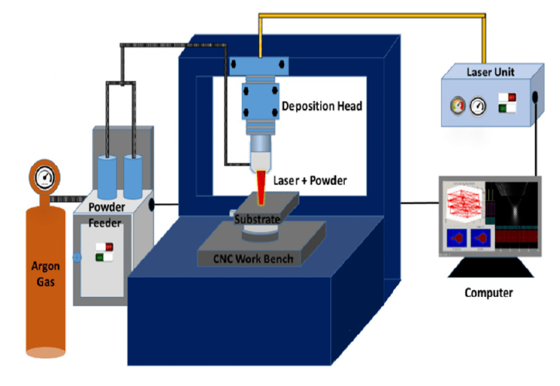

Slide 10
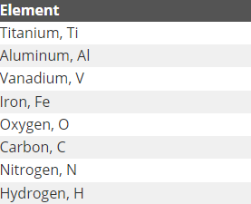
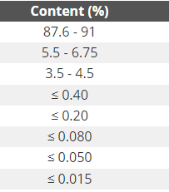
CHEMICAL COMPOSITION:

Slide 11
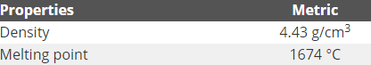
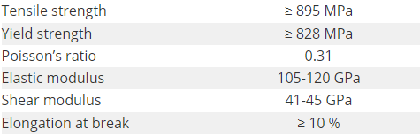
PHYSICAL AND MECHANICAL PROPERTIES:

Slide 12
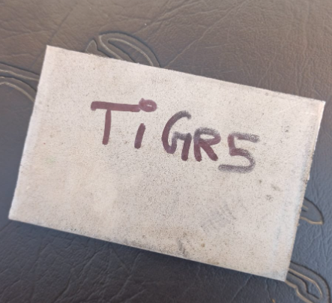
TITANIUM (BASE PLATE):
Length : 100 mm
Breadth : 60 mm
Thickness : 6 mm

Slide 13
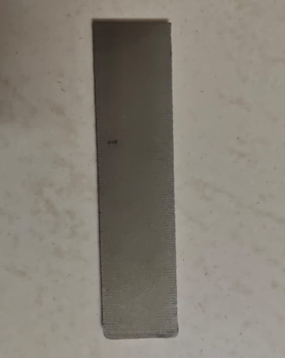
TITANIUM (ADDITIVE):
Length : 120 mm
Breadth : 40 mm
Thickness : 4 mm

Slide 14
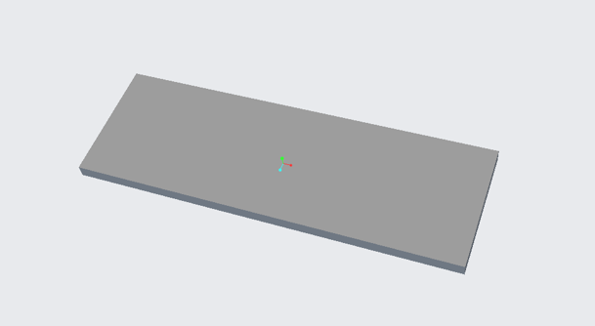
CAD MODEL:

Slide 15
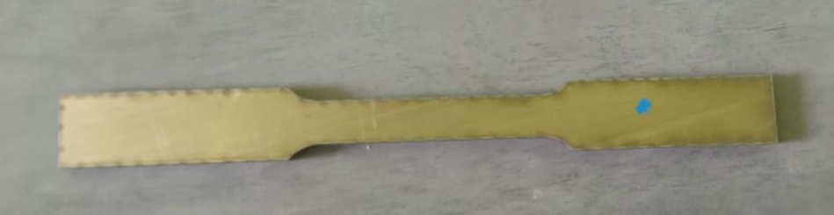
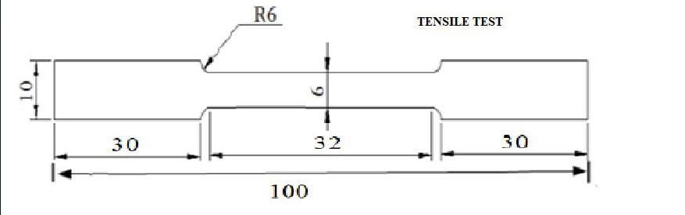
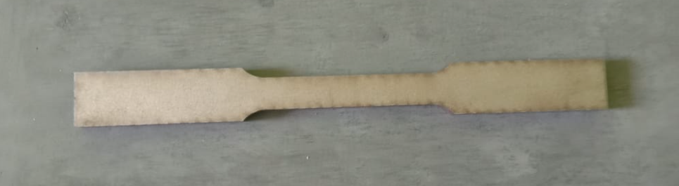
TENSILE TEST:
Additive
Base plate

Slide 16
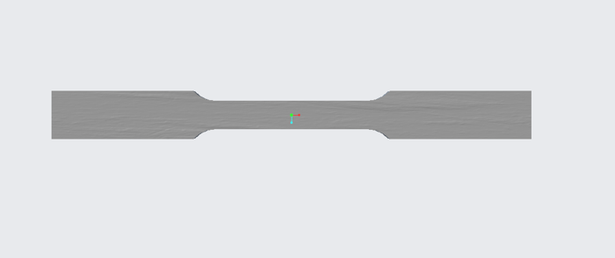
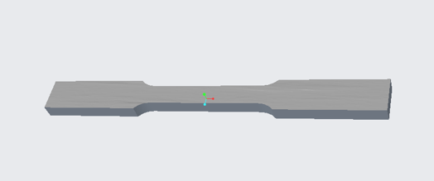
CAD MODEL:
2D VIEW
3D VIEW

Slide 17
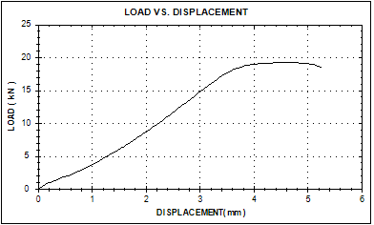
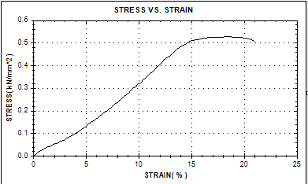
TENSILE RESULTS (ADDITIVE):

Slide 18
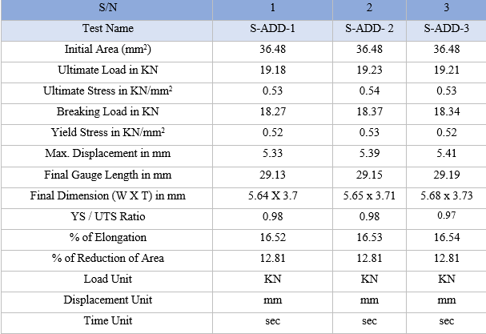

Slide 19
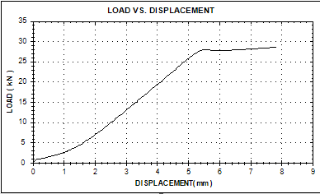
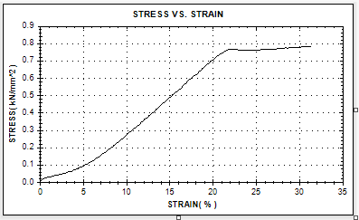
TENSILE RESULTS (BASE PLATE):

Slide 20
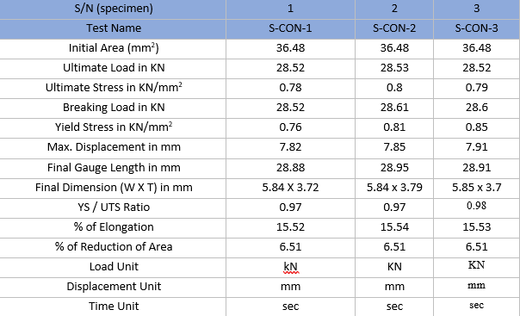

Slide 21
Results of this test:
The tensile strength of Ti6Al4V produced using conventional manufacturing techniques, will be greater than that of components created using additive manufacturing techniques, LMD (Laser Metal Deposition). This is due to the fact that traditional production techniques frequently produce a more uniform microstructure and fewer flaws or imperfections, which can result in greater strength and better mechanical qualities. The Scanning Electron Microscopy test proves this result by analysing the microstructure. Due to layer-by-layer manufacturing of the material, it creates a void or gap between the bonds and makes it low potential for use. Contrarily, the procedures used in additive manufacturing have the potential to produce a number of flaws, including porosity and residual stresses, which could impair the material qualities.

Slide 22
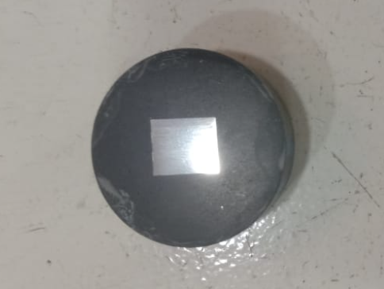
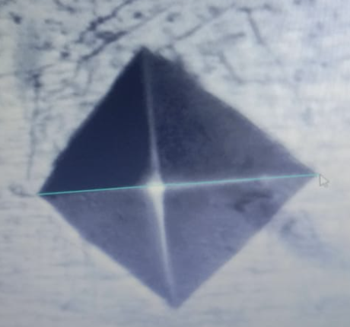
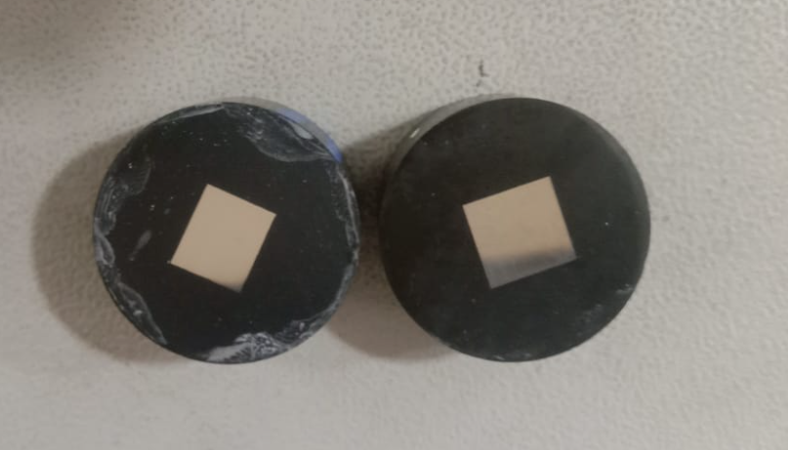
HARDNESS TEST:

Slide 23
HARDNESS RESULTS:
Hardness Measurements:
Load: 1.0 Kgf
Dwell: 10Sec
Unit: H.V @ 0.5 Kgf
Scale: Hardness Vickers

Slide 24
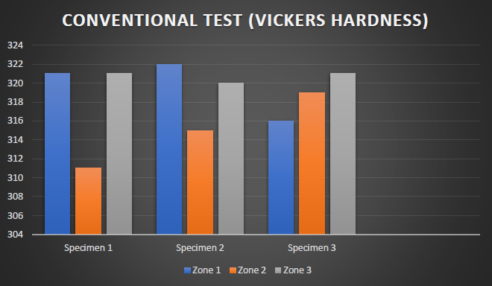
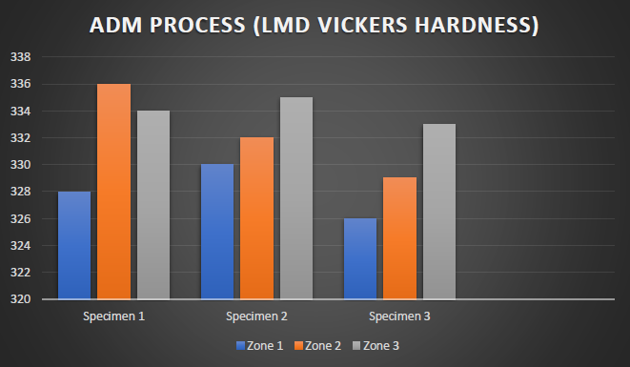

Slide 25
Results of this test:
When compared to Ti6Al4V produced conventionally, the additive manufacturing LMD have even higher hardness values. This is due to the heat treatment of titanium by layer-by-layer deposition process and the ability of LMD to create a fine microstructure with few residual stresses and imperfections, which raises the hardness values. The process also increases the amounts of alloying elements that are present in LMD Ti6Al4V. This reduces the chance of corrosion, which is especially important when working with medical-grade titanium and also for aerospace application.

Slide 26
SEM analysis Conventional Ti6Al4V images:

Slide 27
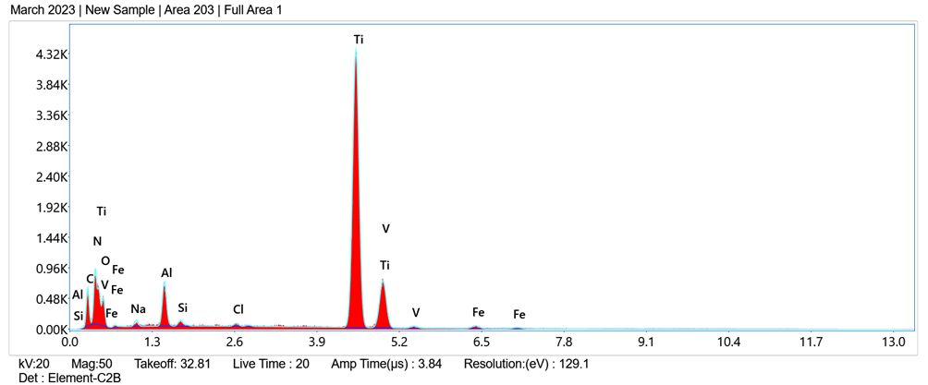
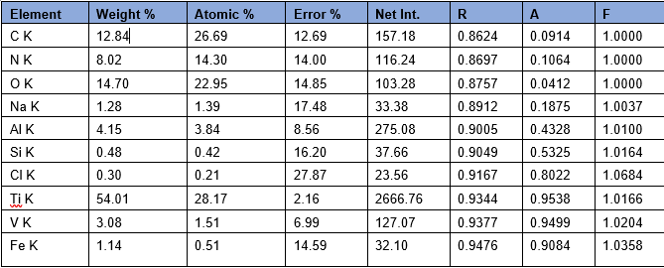

Slide 28
SEM analysis Additive (LMD) Ti6Al4V images:

Slide 29
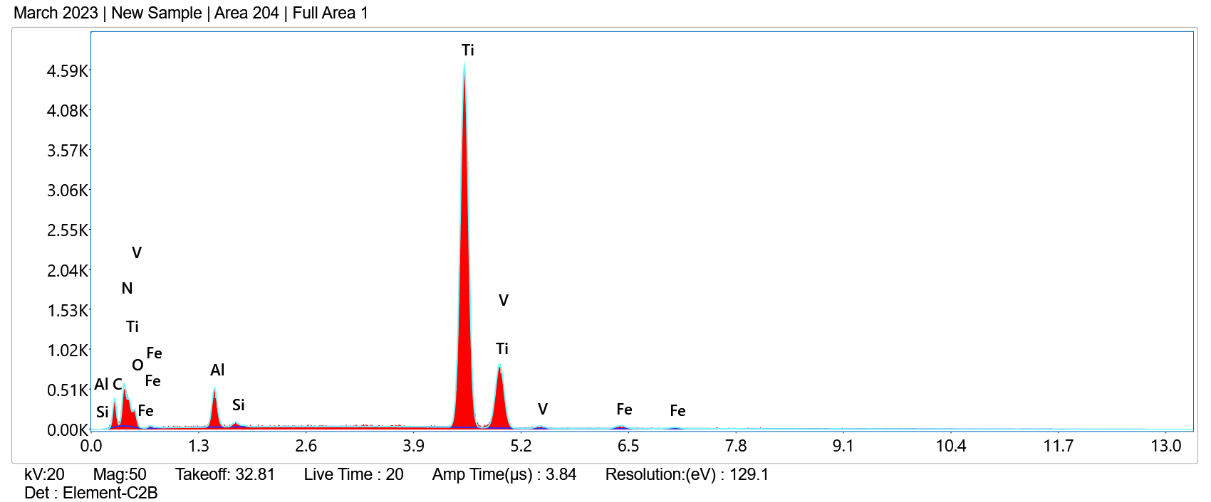
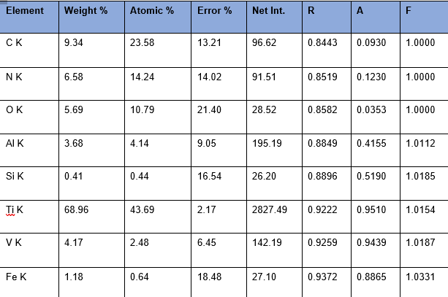

Slide 30
Results of SEM analysis:
From the SEM analysis we can understood that the additively made Titanium has many voids and holes when compared to the conventionally made Titanium. This leads to the cause where the Additively made Titanium breaks easily during the tensile testing. So we came to conclusion that Conventionally made Titanium has the capability to withstand more load.

Slide 31
CONCLUSION
A thorough examination of the microstructure, mechanical properties, and crystal structure of conventional and additively manufactured Ti6Al4V materials revealed significant differences. When compared to the additive-manufactured LMD material, the conventional material had a finer microstructure, lower Vickers hardness, and higher tensile strength. These findings could be attributed to various manufacturing processes and emphasize the importance of proper specimen preparation in material characterization. The study findings may be useful in the design and selection of materials for a variety of engineering applications. According to the test results, the additively made titanium (LMD Ti6Al4V) has shown excellent potential for use in areas like aerospace and biomedicine where corrosion resistance is a crucial need. Further developments and possible tests and upgrades could be in the future.

